Slide 1
Data Center Consolidation

Slide 2
Your Problem → Our Solution
PROBLEM:
Manual process: Slow, inconsistent data, poorly implemented business rules.
SOLUTION:
Streamline and automate the process of submitting, reviewing, and analyzing inventory and cost data for 122 Data Centers.
Consolidate Data Center components for efficient and accurate validation.

Slide 3
Goals & Objectives
Create a user-friendly form to submit quarterly data.
Easily filter and arrange cost data.
Efficiently validate the data.
Automatically calculate cost savings based on quarterly comparisons.
Create an audit trail to view changes.

Slide 4
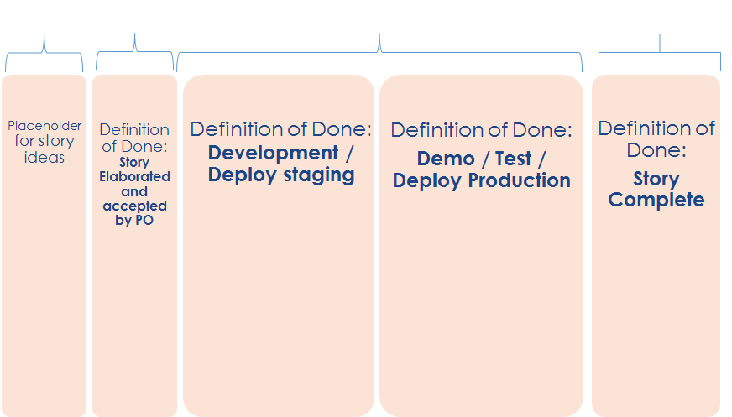
Agile Kanban Approach
Ice Box
Backlog
In Progress
Done

Slide 5
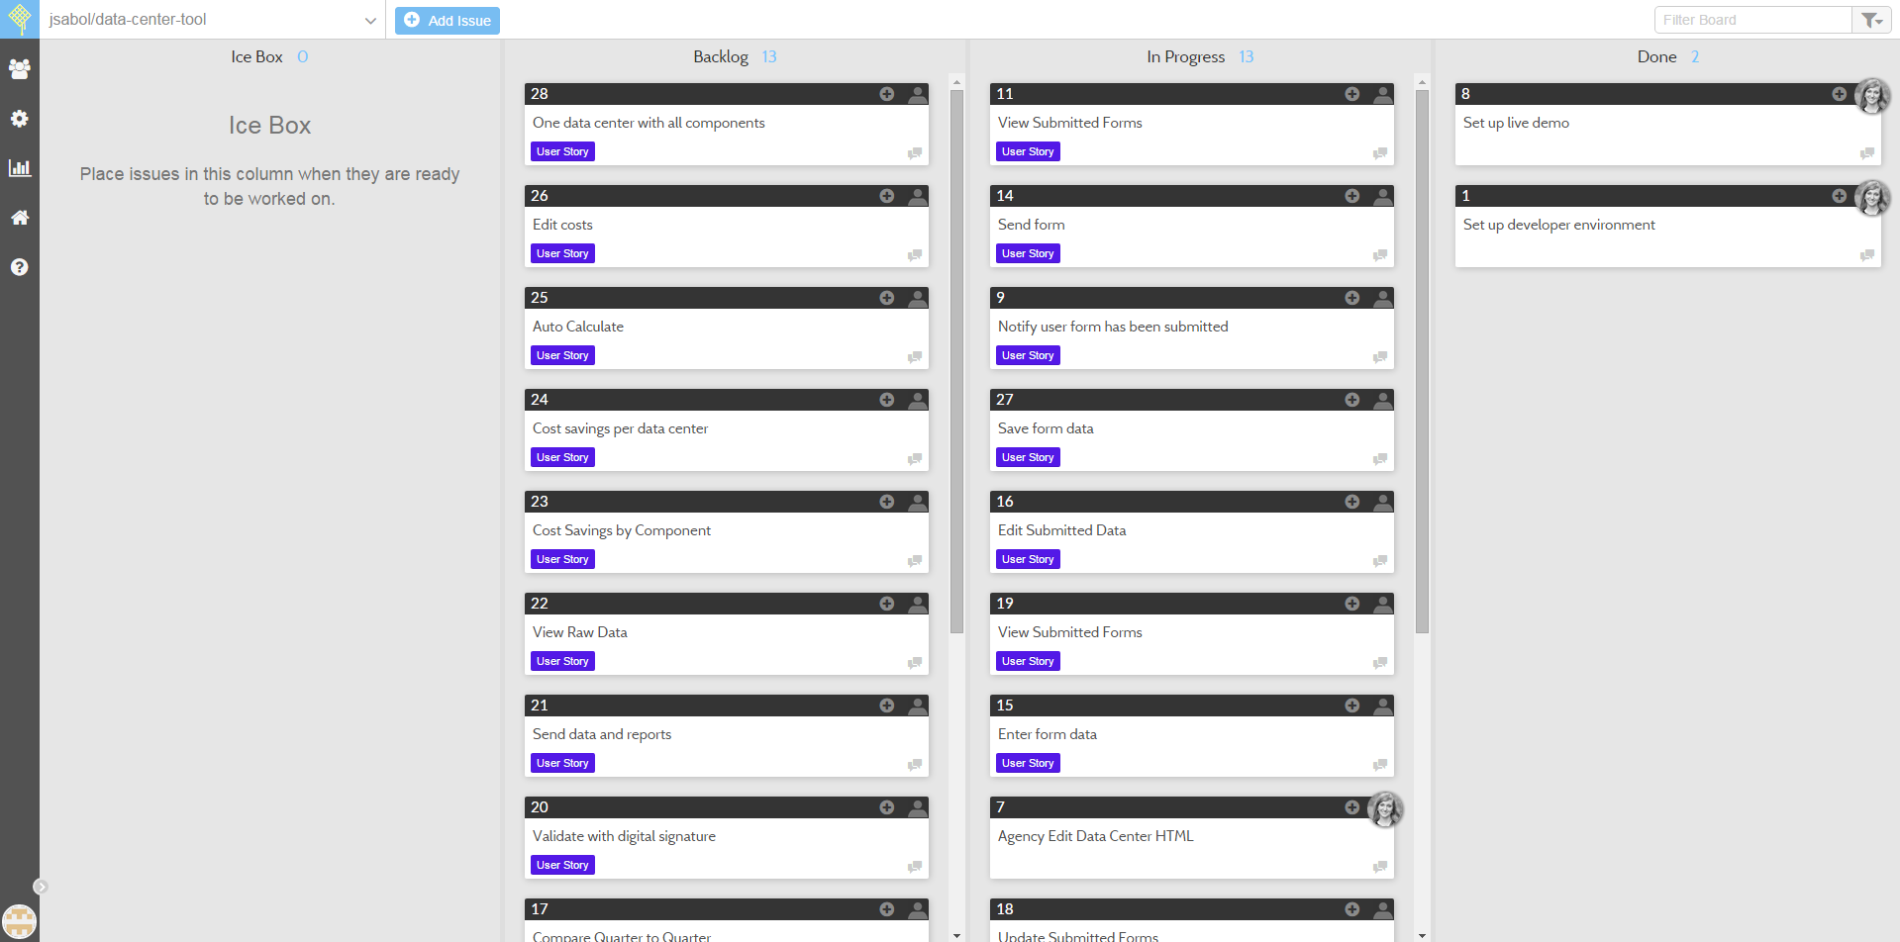
Taskboard: waffle.io

Slide 6










Technologies Used

Slide 7

Staff Office User Persona
Background
Low to middle educational background
Medium level technical comfort
Makes occasional mistakes with extensive manual processes
Objectives
Easy data entry process
Validations to ensure completeness
Easy to submit form

Slide 8

GSA IT User Persona
Background
Bachelor’s or Master’s degree
Experienced with Excel
Overwhelmed with amount of data to clean
Objectives
Streamlined data validation process
Easy to view and edit submitted data forms

Slide 9

Administrative User Persona
Background
Senior Level
Understanding of Data Centers as a whole
Tired of fixing mistakes in the data from other users
Objectives
Easy data validation and submission of data
Simple view of multiple data centers/components
Automatic calculations
Ability to view and filter reports showing cost savings

Slide 10
Demos
c9.io: http://data-center-tool-jsabol.c9.io/hackathon/
iRise: https://try.dc.irise.com:443/iRise/ds/play/49eb4d8639d543d9a54cc67b67f7475f

